Slide 1
Impact of COVID-19 on Food Security in India – Visualization Dashboard

Slide 2
Problem Statement
Alarmed by a potential rise in food insecurity during the COVID-19 pandemic, many countries and organizations are mounting special efforts to keep agriculture safely running as an essential business, markets well supplied in affordable and nutritious food, and consumers still able to access and purchase food despite movement restrictions and income losses.

Slide 3
Proposed Solution
To create a machine learning model to predict the impact of COVID-19 on agriculture and to create Before and After COVID-19 visualizations on agricultural produces.
To create a chatbot to help answer queries regarding impact of the pandemic on food security.

Slide 4
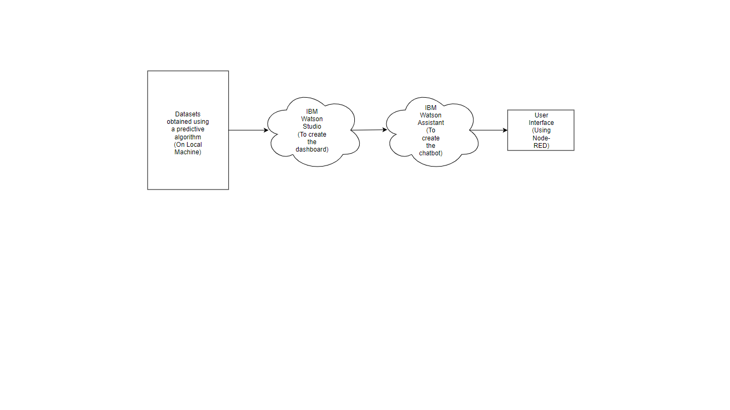
Block Diagram

Slide 5
Design
Prediction of values
Creation of visualizations
Creation of chatbot
Designing the user interface

Slide 6
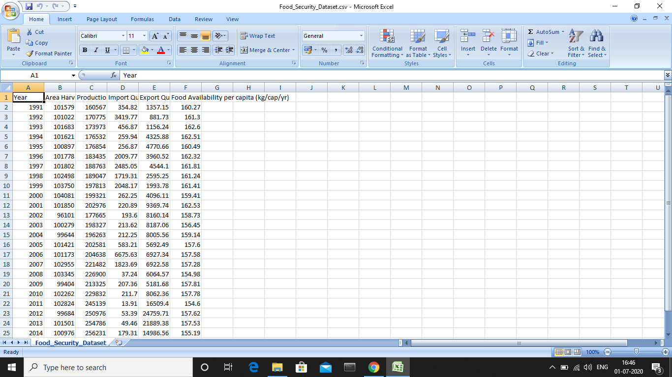
Prediction of values

Slide 7
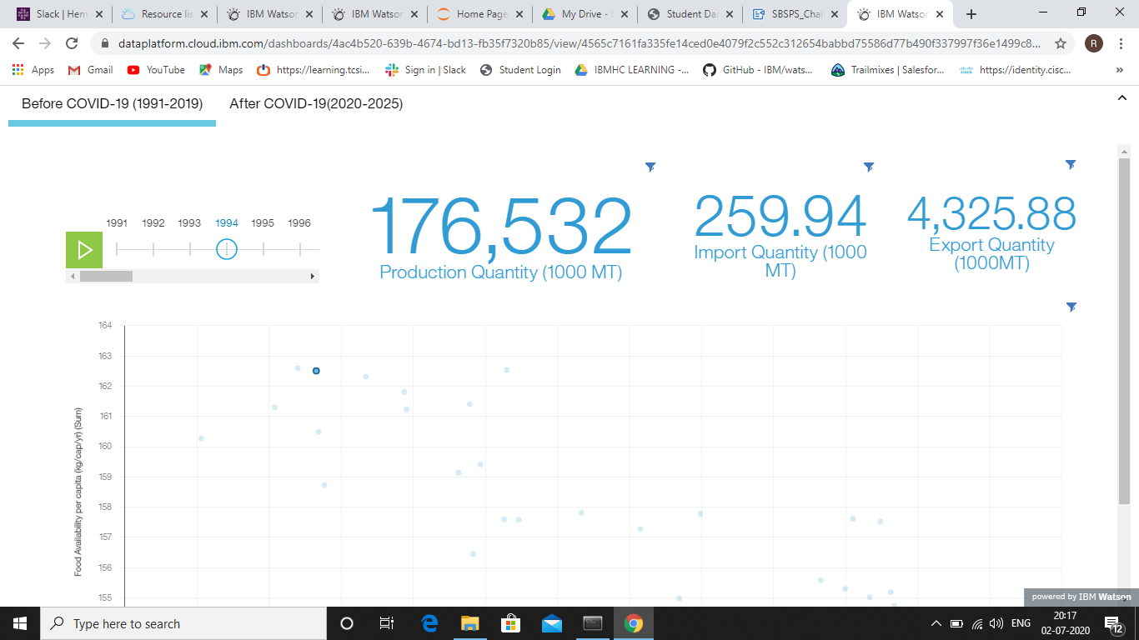
Creation of visualizations

Slide 8
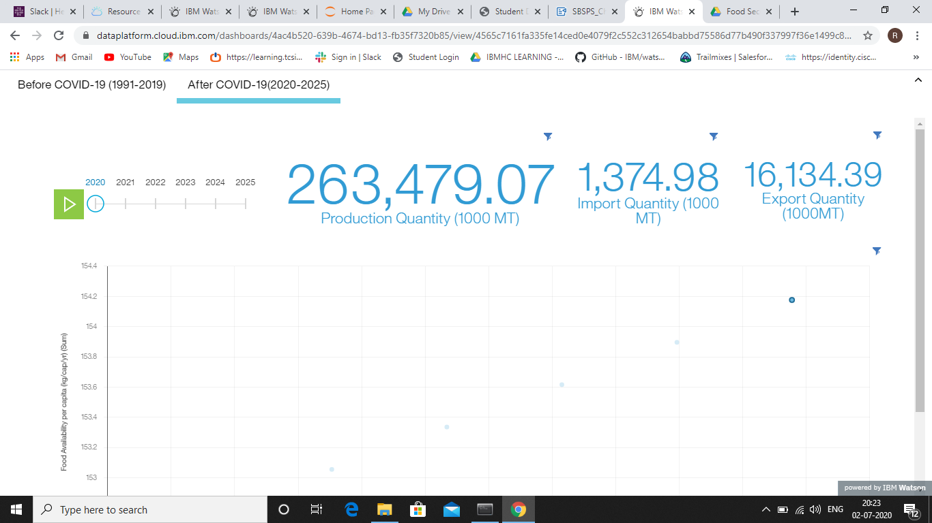
Creation of visualizations

Slide 9
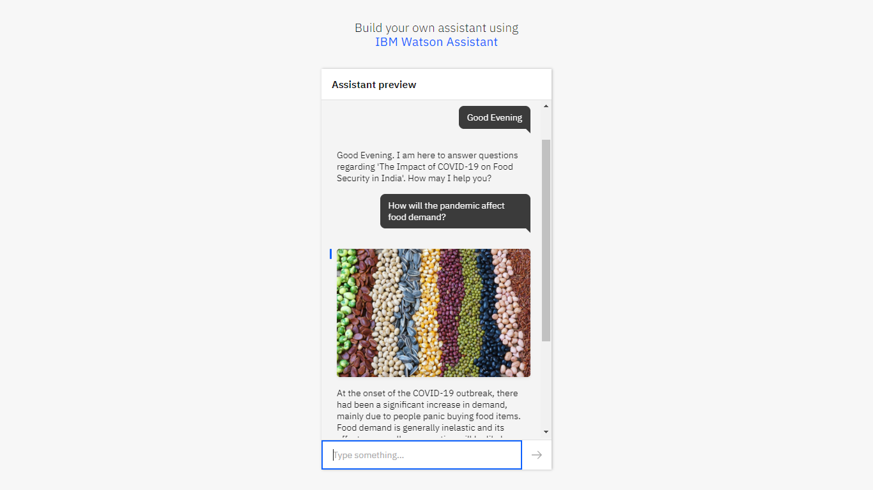
Creation of chatbot

Slide 10
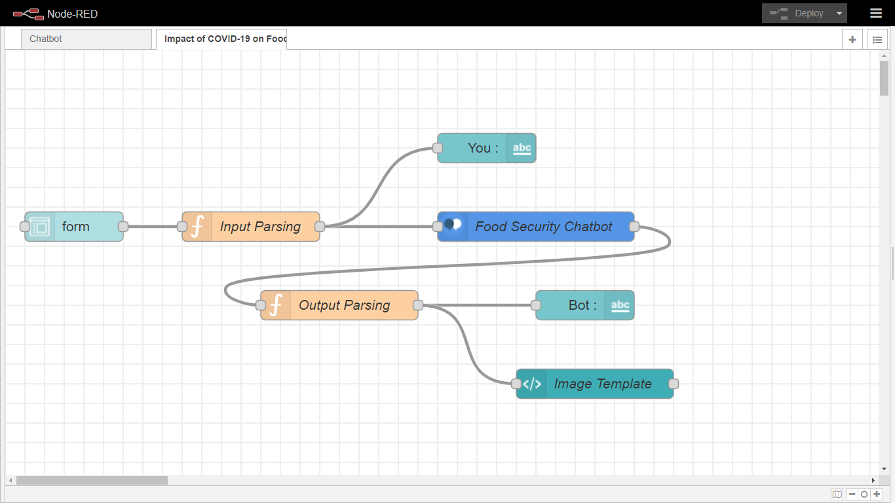
Designing the user interface

Slide 11
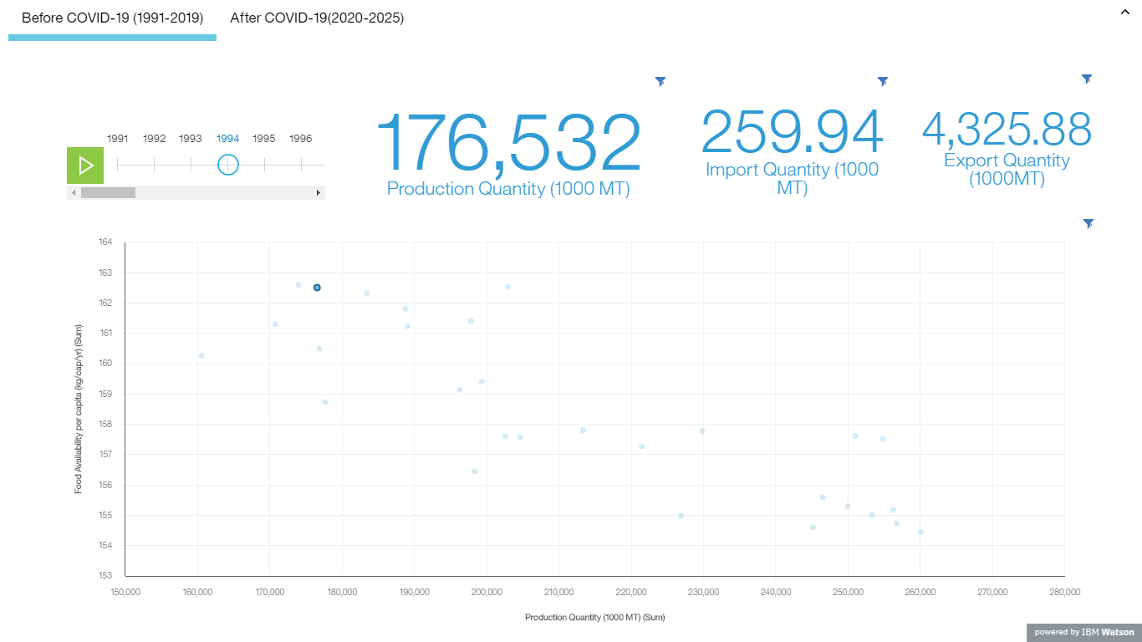
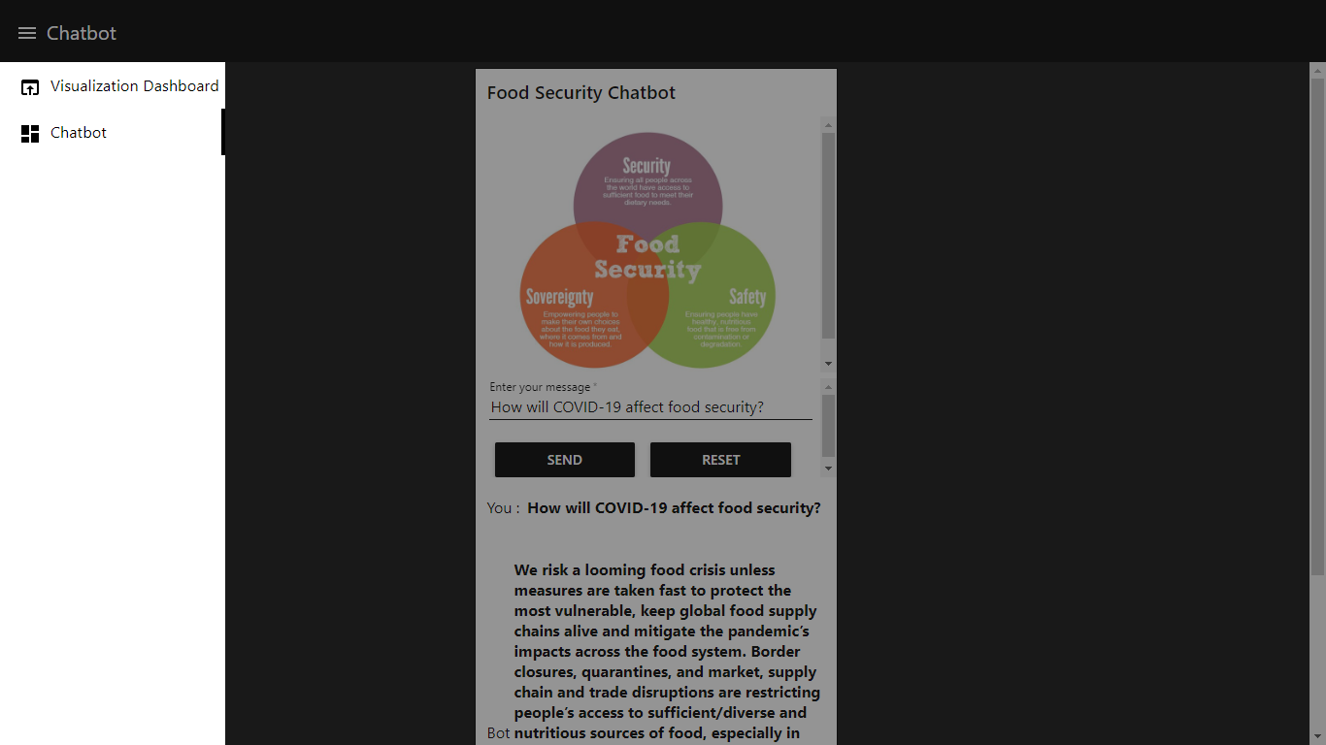
Results

Slide 12
Advantages & Disadvantages
Advantages
Disadvantages
There is no predictive model available on the internet for predicting the impact of the pandemic on food security.
The dashboard has an interactive interface to slide through different years.
The chatbot provides reasons for the impact of the pandemic on food security and tips to minimize it.
There is no accurate and specific data available for accurate and relevant predictions.
The dashboard shows the impact of COVID-19 on food security only for five years i.e. upto 2025.

Slide 13
Future Scope
In future, with more accurate and specific datasets the predictions can be more accurate. Also, relevant changes can be made in the notebook to predict the parameters for even more years.

Slide 14
Conclusion
In conclusion, the overall project provides the solution to the problem statement by creating a visualization dashboard as well as a chatbot to answer food security related questions.

